Slide 1

WORK
EXPERIENCE
LAUNCH
2025-2026
YEAR 12

Slide 2











BENEFITS OF WORK EXPERIENCE
What are the benefits of undertaking work experience?
Providing an opportunity to experience success outside of the classroom and in a work environment
Enhancing knowledge of the demands and expectations of working life
Enabling opportunities for professional, personal, and social development (including self-reflection)
Preparing for the world of work, including developing employability skills
WORK EXPERIENCE BENEFITS
Equipping you with work experience and a potential referee for your CV and future education, training, and employment applications
Giving an insight into the knowledge, skills, and qualities required for particular jobs, industries, and employers
Helping you understand how your school studies are relevant and useful in the workplace
Allowing you to try a vocational preference to help you make realistic and informed post-18 decisions

Slide 3






YEAR 12 WORK EXPERIENCE ROADMAP
This year, Year 12 Work Experience Week is: Monday 8th June - Friday 12th June 2026
Thursday 23rd April 2026
April/May 2026
Tuesday 26th May
w/c Monday 8th June
Deadline to submit Unifrog placement form (student, employer, and parent sections).
Work experience preparation RHPD lesson.
Deadline to undertake pre-placement interview.
Year 12 Work Experience Week.
27th January 2026
THE WEALD PERMISSIONS PROCESSED
w/c Monday 15th July
Work Experience Launch Events (Student and Parent)
You cannot start your work experience placement until you have received permission from The Weald via your Unifrog placements form.
Work experience debrief RHPD lesson.

Slide 4
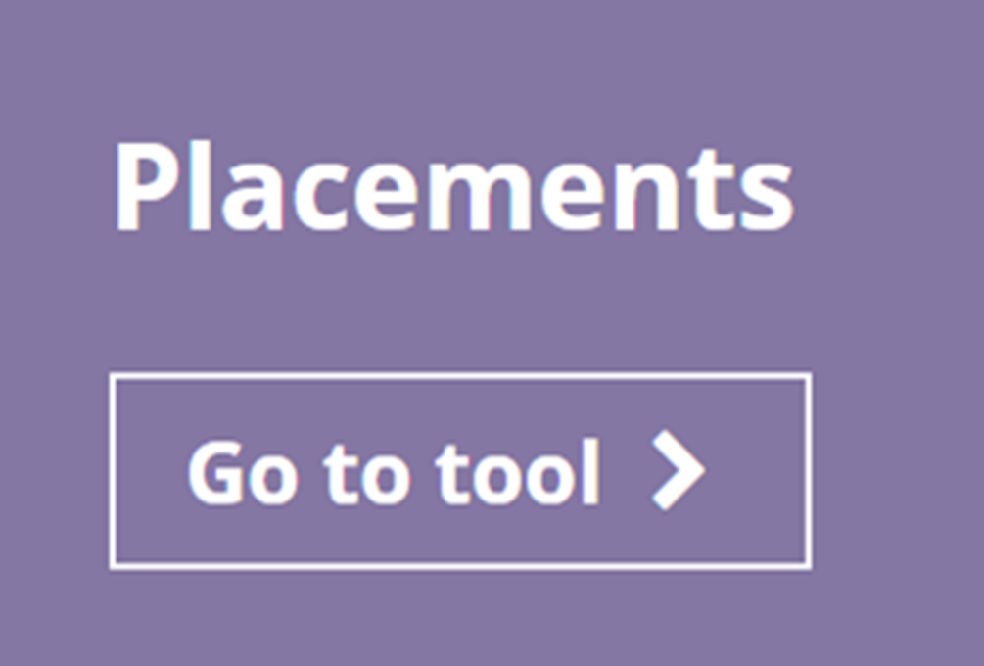



HEALTH AND SAFETY
The placement must be in person and in the UK and the employer is responsible for managing health and safety risks.
However, The Weald has a duty to satisfy ourselves that employers will fulfil these health and safety responsibilities.
For this reason, you must apply for permission to undertake your work experience placement with the Weald
This involves completing a placement form on Unifrog.

Slide 5
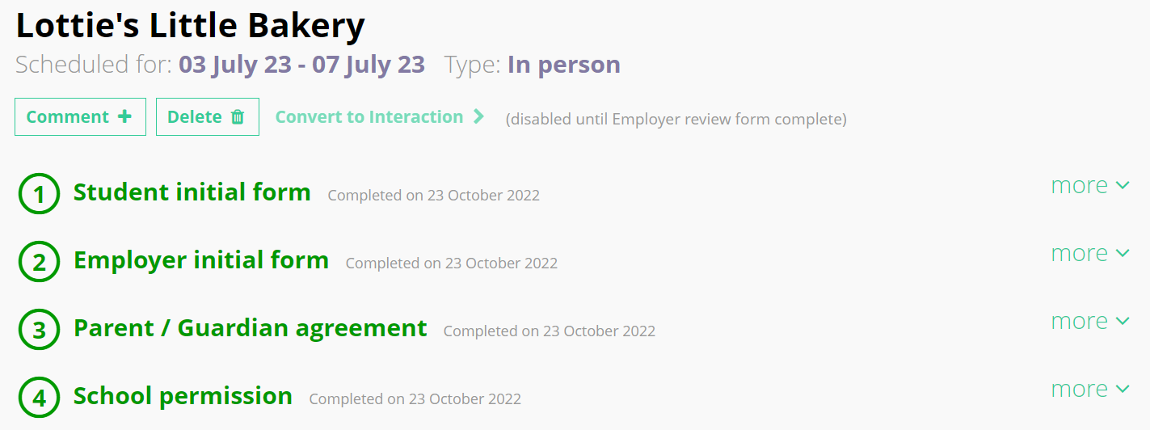
UNIFROG PLACEMENTS FORM
There are three sections to the Unifrog placement form that must be submitted by Thursday 23rd April 2026:
_____________________
placements must be in person
___________
___________
___________
___________
You cannot start your work experience placement until you have received permission from The Weald via your Unifrog placements form!

Slide 6

UNIFROG PLACEMENTS FORM
If you need help with the Unifrog placements form…
… use the Unifrog Placements Tool Guide which can be found on the careers website
(you can also send this to the employer)
If you are still stuck, email Careers via careers@theweald.org.uk

Slide 7

FINDING WORK EXPERIENCE
You are expected to find your own work experience placement because this...
Allows you to find a placement you will find most useful
Helps you develop important employability skills for the future
Let’s explore how to successfully find a work experience placement…

Slide 8




FINDING WORK EXPERIENCE
If you are interested in a work experience placement with any of the below…
Notes:
Very rare to get WEX here - join St John ambulance cadets, police cadets, army cadets. Unless have a personal contact. Think of skills - public facing for police, care sector for NHS and charities - easier to get into… Medicine longer volunteering - different skill set. Virtual placements exist for medicine.

Slide 9

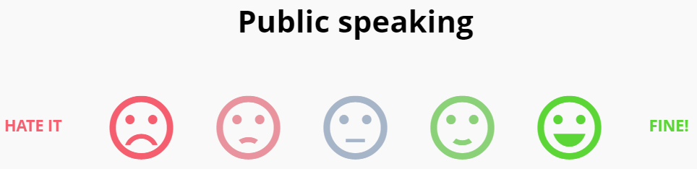
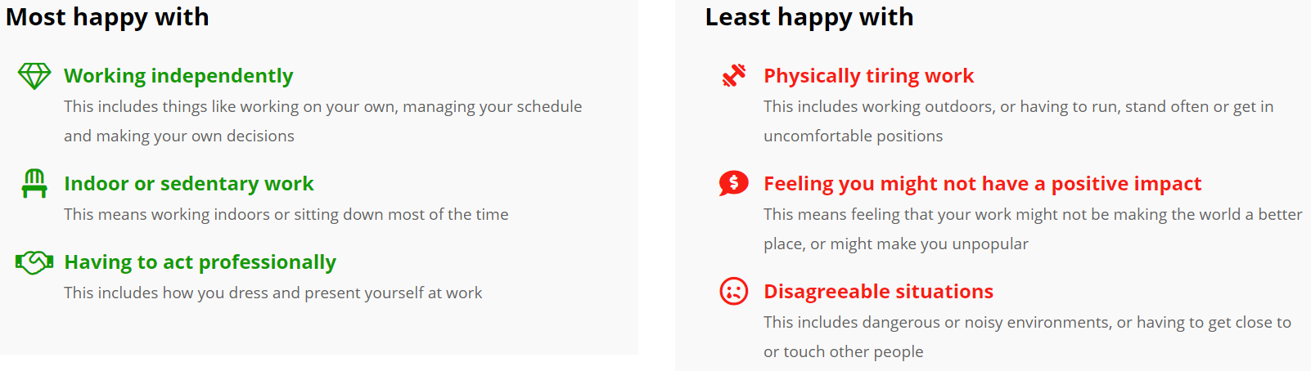
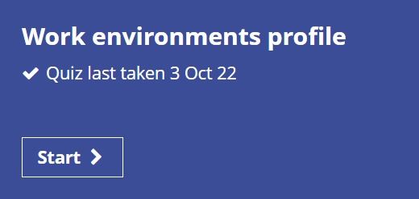

FINDING WORK EXPERIENCE
Not sure what to gain work experience in?
Take the ‘Work Environments Profile’ quiz on Unifrog to explore your workplace and job preferences!

Slide 10
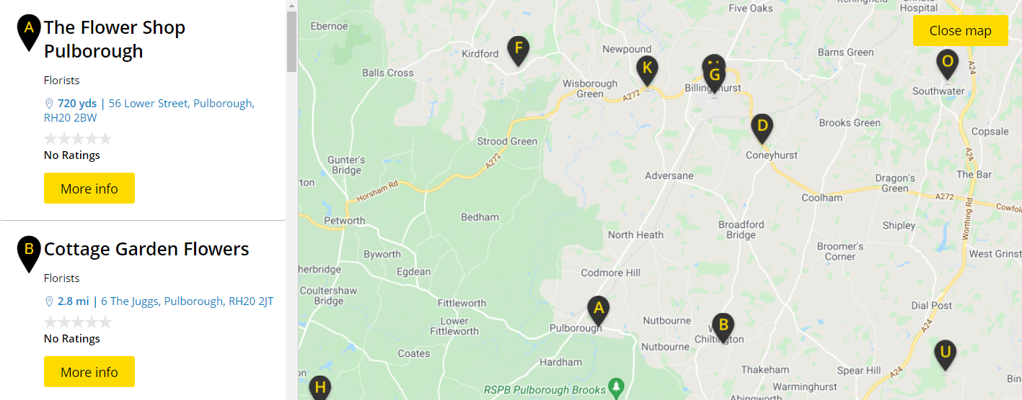
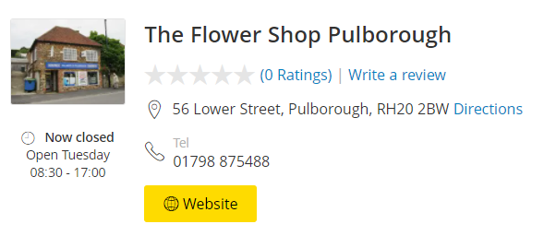
FINDING WORK EXPERIENCE
Search for local employers using Yell.

Slide 11

FINDING WORK EXPERIENCE
You may also have contacts through your family and/or friends to request a work experience placement with.
Notes:
Start with contacts

Slide 12
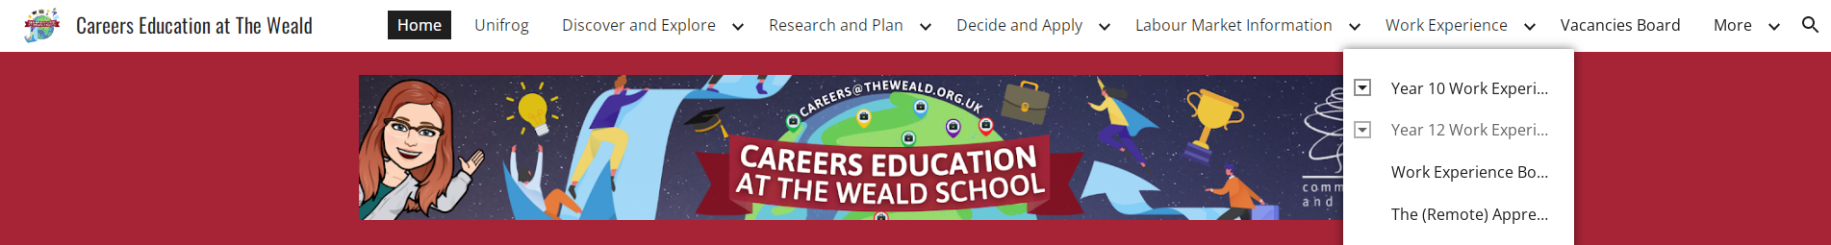

WORK EXPERIENCE COMMUNITY DATABASE
Search The Weald’s work experience community database for employers who are happy to consider placement requests!

Slide 13
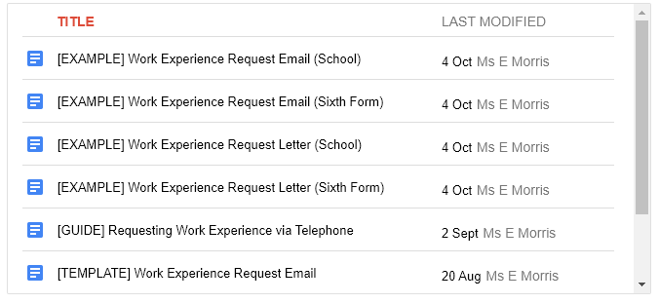
TEMPLATES AND EXAMPLES
Use the guides, examples, and template on the The Weald’s careers site to help you with contacting employers and asking them for a work experience placement.
Be brave - this is a great opportunity to practise your networking skills and build your confidence!
Notes:
Parent and child to do TOGETHER - don’t do it for them! Skills involved and more invested

Slide 14
FAQ’s:
Q: What happens if we are not able to secure a placement?
The vast majority of our students find a placement without any problem as long as they start well in advance of the deadline.
Use Yell for local employers and use family/friend contacts. Remember, this does not have to be your ‘dream job’
All work experience builds skills, confidence and employability.
Q: Can under 16s get a DBS report?
You should not require a DBS, as you will not be ‘loan working’. You should be assigned a key worker in any setting that requires DBS and be shadowing them, so you would not be on your own and therefore do not require a DBS.
Q: Do the students have a unifrog login already ?
Yes, Weald students should have a log in already. If there are any problems with this, please email careers@theweald.org.uk
Q: Do Employer and Parent permission also need to be done by 23rd April 2026?
Yes
Q: How many hours do they need to do per day?
Whatever a ‘typical working day’ is for that work place (ie could be 8am-4pm, could have a later start 10am-6pm etc)
Q: Is there any type of placement a child is not allowed to work ?
All work experience providers need to have Employer’s Liability Insurance. Self-employed placements are not recommended for this reason.
Q: If we have found work experience and had it confirmed, where do we update this so it flows through the system?
Via Unifrog

Slide 15
YEAR 12 WORK EXPERIENCE
Good Luck!
If you require any support then please speak to Mrs Goodlad B30 or email careers@theweald.org.uk
Notes:
Q+A

